Slide 1
Fundamentals of Data Science
Ch 3: Machine learning
First Semester 2022/2023

Slide 2
This chapter covers:
Understanding why data scientists use machine learning
Identifying the most important Python libraries for machine learning
Discussing the process for model building
Using machine learning techniques
Gaining hands-on experience with machine learning

Slide 3
What is machine learning and why should you care about it?
“Machine learning is a field of study that gives computers the ability to learn without being explicitly programmed.” —Arthur Samuel, 1959
The definition of machine learning coined by Arthur Samuel is often quoted and is genius in its broadness, but it leaves you with the question of how the computer learns. To achieve machine learning, experts develop general-purpose algorithms that can be used on large classes of learning problems. When you want to solve a specific task you only need to feed the algorithm more specific data. In a way, you’re programming by example.

Slide 4
What is machine learning and why should you care about it?
In most cases a computer will use data as its source of information and compare its output to a desired output and then correct for it. The more data or “experience” the computer gets, the better it becomes at its designated job, like a human does. When machine learning is seen as a process, the following definition is insightful:
“Machine learning is the process by which a computer can work more accurately as it collects and learns from the data it is given.” —Mike Roberts2
For example, as a user writes more text messages on a phone, the phone learns more about the messages’ common vocabulary and can predict (autocomplete) their words faster and more accurately. In the broader field of science, machine learning is a subfield of artificial intelligence and is closely related to applied mathematics and statistics. All this might sound a bit abstract, but machine learning has many applications in everyday life.

Slide 5
Applications for machine learning in data science
Regression and classification are of primary importance to a data scientist. To achieve these goals, one of the main tools a data scientist uses is machine learning. The uses for regression and automatic classification are wide ranging, such as the following:
■ Finding oil fields, gold mines, or archeological sites based on existing sites (classification and regression)
■ Finding place names or persons in text (classification)
■ Identifying people based on pictures or voice recordings (classification)
■ Recognizing birds based on their whistle (classification)

Slide 6
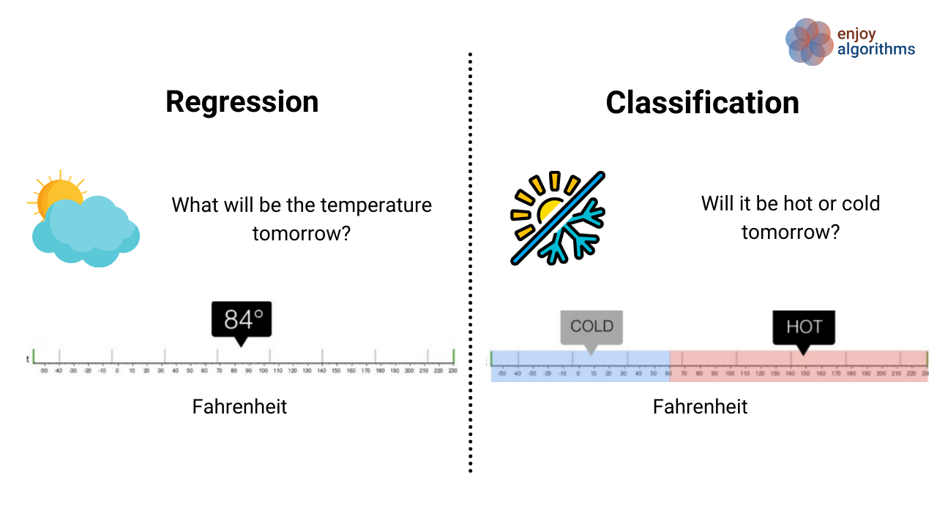
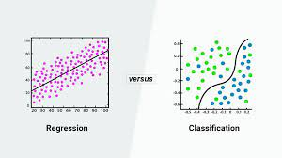
Regression and Classification

Slide 7
Applications for machine learning in data science
■ Identifying profitable customers (regression and classification)
■ Proactively identifying car parts that are likely to fail (regression)
■ Identifying tumors and diseases (classification)
■ Predicting the amount of money a person will spend on product X (regression)
■ Predicting the number of eruptions of a volcano in a period (regression)
■ Predicting your company’s yearly revenue (regression)
■ Predicting which team will win the Champions League in soccer (classification)

Slide 8
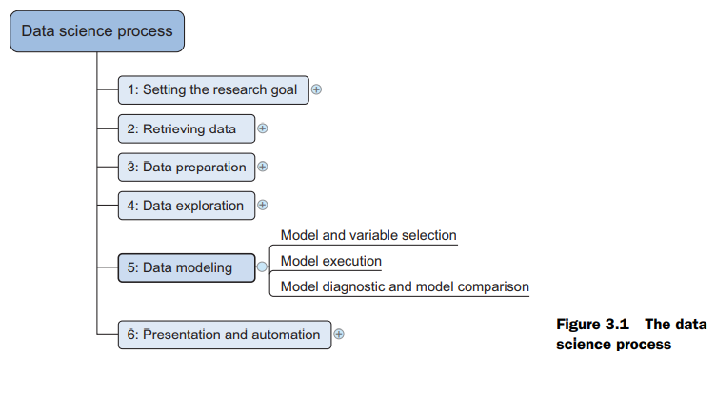
Where machine learning is used in the data science process
Although machine learning is mainly linked to the data-modeling step of the data science process, it can be used at almost every step. To refresh your memory from previous chapters, the data science process is shown in figure 3.1.
The data modeling phase can’t start until you have qualitative raw data you can understand. But prior to that, the data preparation phase can benefit from the use of machine learning. An example would be cleansing a list of text strings; machine learning can group similar strings together so it becomes easier to correct spelling errors.

Slide 9
Where machine learning is used in the data science process
Machine learning is also useful when exploring data. Algorithms can root out underlying patterns in the data where they’d be difficult to find with only charts.
Given that machine learning is useful throughout the data science process, it shouldn’t come as a surprise that a considerable number of Python libraries were developed to make your life a bit easier.

Slide 10
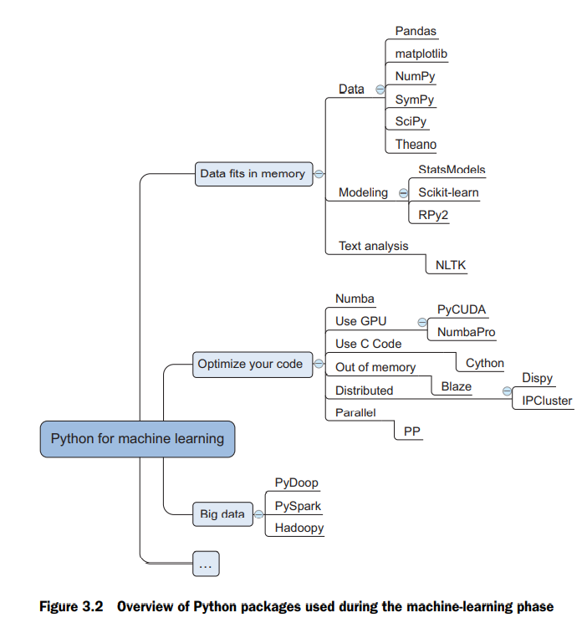
Python tools used in machine learning
Python has an overwhelming number of packages that can be used in a machine learning setting. The Python machine learning ecosystem can be divided into three main types of packages, as shown in figure 3.2.
The first type of package shown in figure 3.2 is mainly used in simple tasks and when data fits into memory. The second type is used to optimize your code when you’ve finished prototyping and run into speed or memory issues. The third type is specific to using Python with big data technologies.

Slide 11
PACKAGES FOR WORKING WITH DATA IN MEMORY
When prototyping, the following packages can get you started by providing advanced functionalities with a few lines of code:
■ SciPy is a library that integrates fundamental packages often used in scientific computing such as NumPy, matplotlib, Pandas, and SymPy.
■ NumPy gives you access to powerful array functions and linear algebra functions.
■ Matplotlib is a popular 2D plotting package with some 3D functionality.
■ Pandas is a high-performance, but easy-to-use, data-wrangling package. It introduces dataframes to Python, a type of in-memory data table. It’s a concept that should sound familiar to regular users of R.
■ SymPy is a package used for symbolic mathematics and computer algebra.
■ StatsModels is a package for statistical methods and algorithms.
■ Scikit-learn is a library filled with machine learning algorithms.
■ RPy2 allows you to call R functions from within Python. R is a popular open source statistics program.
■ NLTK (Natural Language Toolkit) is a Python toolkit with a focus on text analytics. These libraries are good to get started with, but once you make the decision to run a certain Python program at frequent intervals, performance comes into play.

Slide 12
OPTIMIZING OPERATIONS
Once your application moves into production, the libraries listed here can help you deliver the speed you need. Sometimes this involves connecting to big data infrastructures such as Hadoop and Spark.
■ Numba and NumbaPro—These use just-in-time compilation to speed up applications written directly in Python and a few annotations. NumbaPro also allows you to use the power of your graphics processor unit (GPU).
■ PyCUDA—This allows you to write code that will be executed on the GPU instead of your CPU and is therefore ideal for calculation-heavy applications. It works best with problems that lend themselves to being parallelized and need little input compared to the number of required computing cycles. An example is studying the robustness of your predictions by calculating thousands of different outcomes based on a single start state.
■ Cython, or C for Python—This brings the C programming language to Python. C is a lower-level language, so the code is closer to what the computer eventually uses (bytecode). The closer code is to bits and bytes, the faster it executes. A computer is also faster when it knows the type of a variable (called static typing). Python wasn’t designed to do this, and Cython helps you to overcome this shortfall

Slide 13
OPTIMIZING OPERATIONS
■ Blaze—Blaze gives you data structures that can be bigger than your computer’s main memory, enabling you to work with large data sets. Dispy and IPCluster—These packages allow you to write code that can be distributed over a cluster of computers.
■ PP—Python is executed as a single process by default. With the help of PP you can parallelize computations on a single machine or over clusters.
■ Pydoop and Hadoopy—These connect Python to Hadoop, a common big data framework.
■ PySpark—This connects Python and Spark, an in-memory big data framework. Now that you’ve seen an overview of the available libraries, let’s look at the modeling process itself.

Slide 14
The modeling process
The modeling phase consists of four steps:
Feature engineering and model selection
Training the model
Model validation and selection
Applying the trained model to unseen data

Slide 15
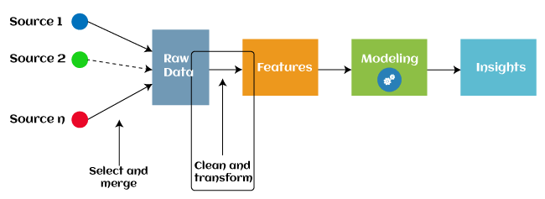
1. Engineering features and selecting a model
With engineering features, you must come up with and create possible predictors for the model. This is one of the most important steps in the process because a model recombines these features to achieve its predictions. Often you may need to consult an expert or the appropriate literature to come up with meaningful features.
Certain features are the variables you get from a data set, as is the case with the provided data sets in our exercises and in most school exercises. In practice you’ll need to find the features yourself, which may be scattered among different data sets. In several projects we had to bring together more than 20 different data sources before we had the raw data we required. Often you’ll need to apply a transformation to an input before it becomes a good predictor or to combine multiple inputs

Slide 16
2. Training your model
With the right predictors in place and a modeling technique in mind, you can progress to model training. In this phase you present to your model data from which it can learn.
The most common modeling techniques have industry-ready implementations in almost every programming language, including Python. These enable you to train your models by executing a few lines of code. For more state-of-the art data science techniques, you’ll probably end up doing heavy mathematical calculations and implementing them with modern computer science techniques.
Once a model is trained, it’s time to test whether it can be extrapolated to reality: model validation

Slide 17
3. Validating a model
Two common error measures in machine learning are:
Classification error rate for classification problems and
Mean squared error for regression problems.
The classification error rate is the percentage of observations in the test data set that your model mislabeled; lower is better.
The mean squared error measures how big the average error of your prediction is.

Slide 18
3. Validating a model
Many validation strategies exist, including the following common ones:
■ Dividing your data into a training set with X% of the observations and keeping the rest as a holdout data set (a data set that’s never used for model creation)—This is the most common technique.
■ K-folds cross validation—This strategy divides the data set into k parts and uses each part one time as a test data set while using the others as a training data set. This has the advantage that you use all the data available in the data set.
■ Leave-1 out—This approach is the same as k-folds but with k=1. You always leave one observation out and train on the rest of the data. This is used only on small data sets, so it’s more valuable to people evaluating laboratory experiments than to big data analys

Slide 19
4. Predicting new observations
If you’ve implemented the first three steps successfully, you now have a performant model that generalizes to unseen data. The process of applying your model to new data is called model scoring. In fact, model scoring is something you implicitly did during validation, only now you don’t know the correct outcome. By now you should trust your model enough to use it for real.
Model scoring involves two steps. First, you prepare a data set that has features exactly as defined by your model. This boils down to repeating the data preparation you did in step one of the modeling process but for a new data set. Then you apply the model on this new data set, and this results in a prediction.

Slide 20
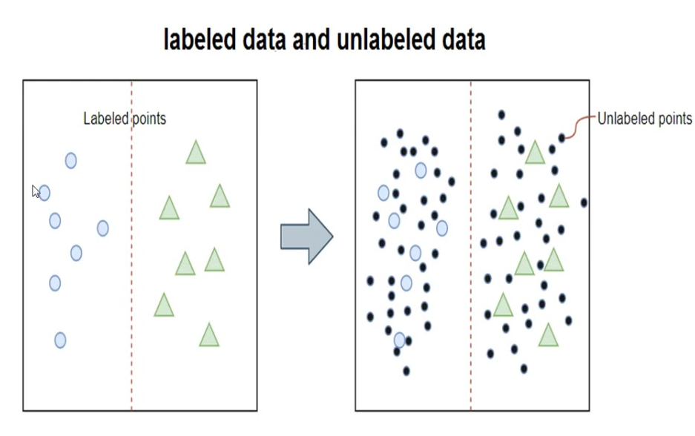
Types of machine learning
Supervised learning techniques attempt to discern results and learn by trying to find patterns in a labeled data set. Human interaction is required to label the data.
Unsupervised learning techniques don’t rely on labeled data and attempt to find patterns in a data set without human interaction.
Semi-supervised learning techniques need labeled data, and therefore human interaction, to find patterns in the data set, but they can still progress toward a result and learn even if passed unlabeled data as well.

Slide 21
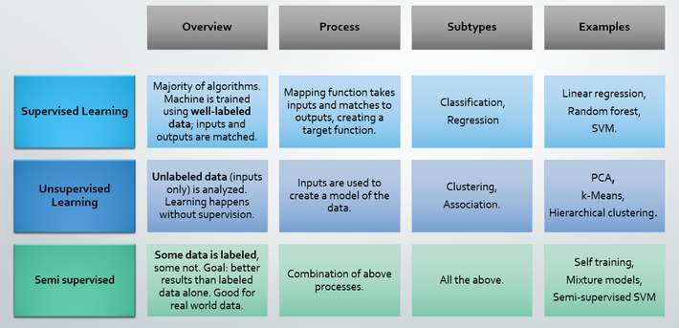
Types of machine learning

